Slide 1
Shrek--
Clayton Bruce, Sung Jae Ko, & Dylan Lim

Slide 2
Contents of Shrek–-
Story behind Shrek--:
What is a part of Dreamworks and has funny characters and diction?
Shrek employs humor and satire to convey its messages.
We based our language off the movies and incorporated those satirical objects and phrases.
We also hope our language will inspire shrek fans to learn to code.
Here’s what you’ll find in Shrek--:
Statically & Strongly typed
Curly brace and semicolon styling
ogre = function, if = whitevur, pinocchio = boolean (truth/lie), sing() = print()
Notes:
When we first started this project, we all thought, “what is a movie or tv show that has funny words?”, after some thinking we decided that Shrek was the perfect fit for both funny and unique characters and words. Shrek’s unique language helps to establish its distinct tone and humor, making it easily recognizable and memorable, so we based our programming language off the movies and incorporated their satirical beings and phrases and made Shrek– into what it is today.

Slide 3
What’s special about Shrek–- ?
These languages all have a niche to them that stands out
languages with references can make the learning process easier
-Practicing different languages and understanding the various ways problems can be addressed help develop skills

Slide 4
Distinguishing Features
Enchanted a ~ <shilling,pinocchio>[]
X ~ 3
Y <- X
tao
Sum Types
Assignment by value
Assignment by reference
2pi instead of pi for big brain math

Slide 5
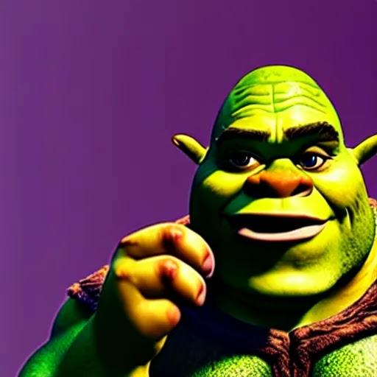
What about some code?
https://openart.ai/discovery/sd-1008132168670781570

Slide 6
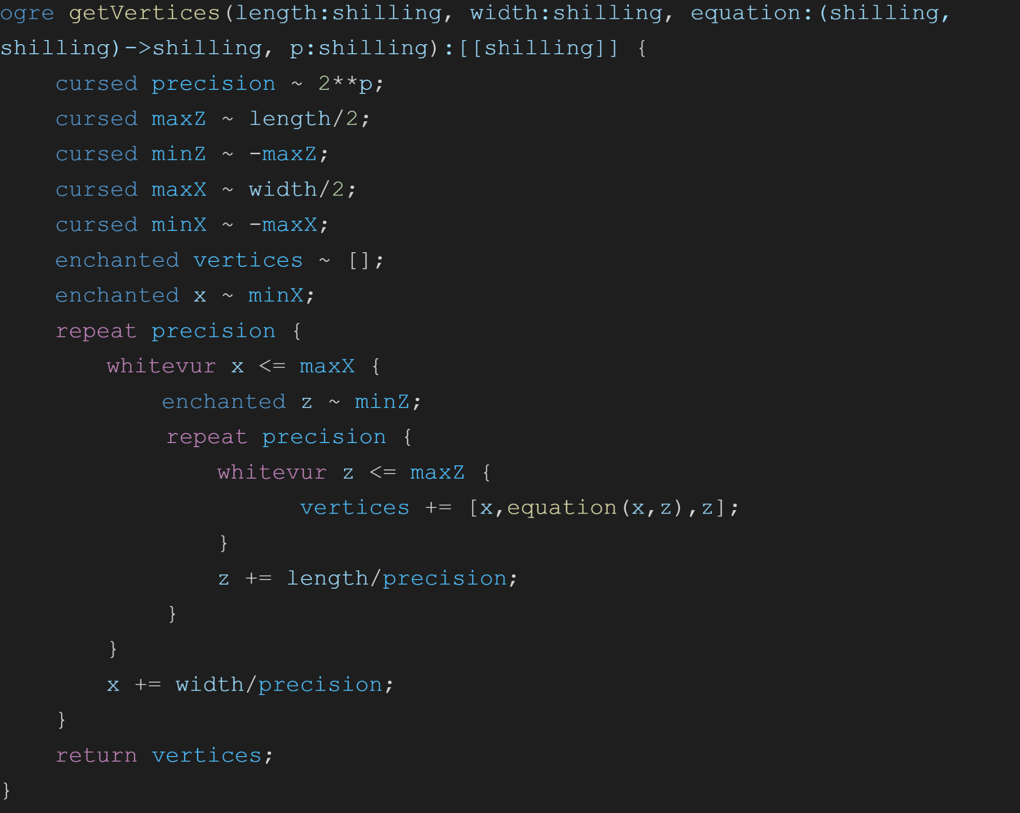
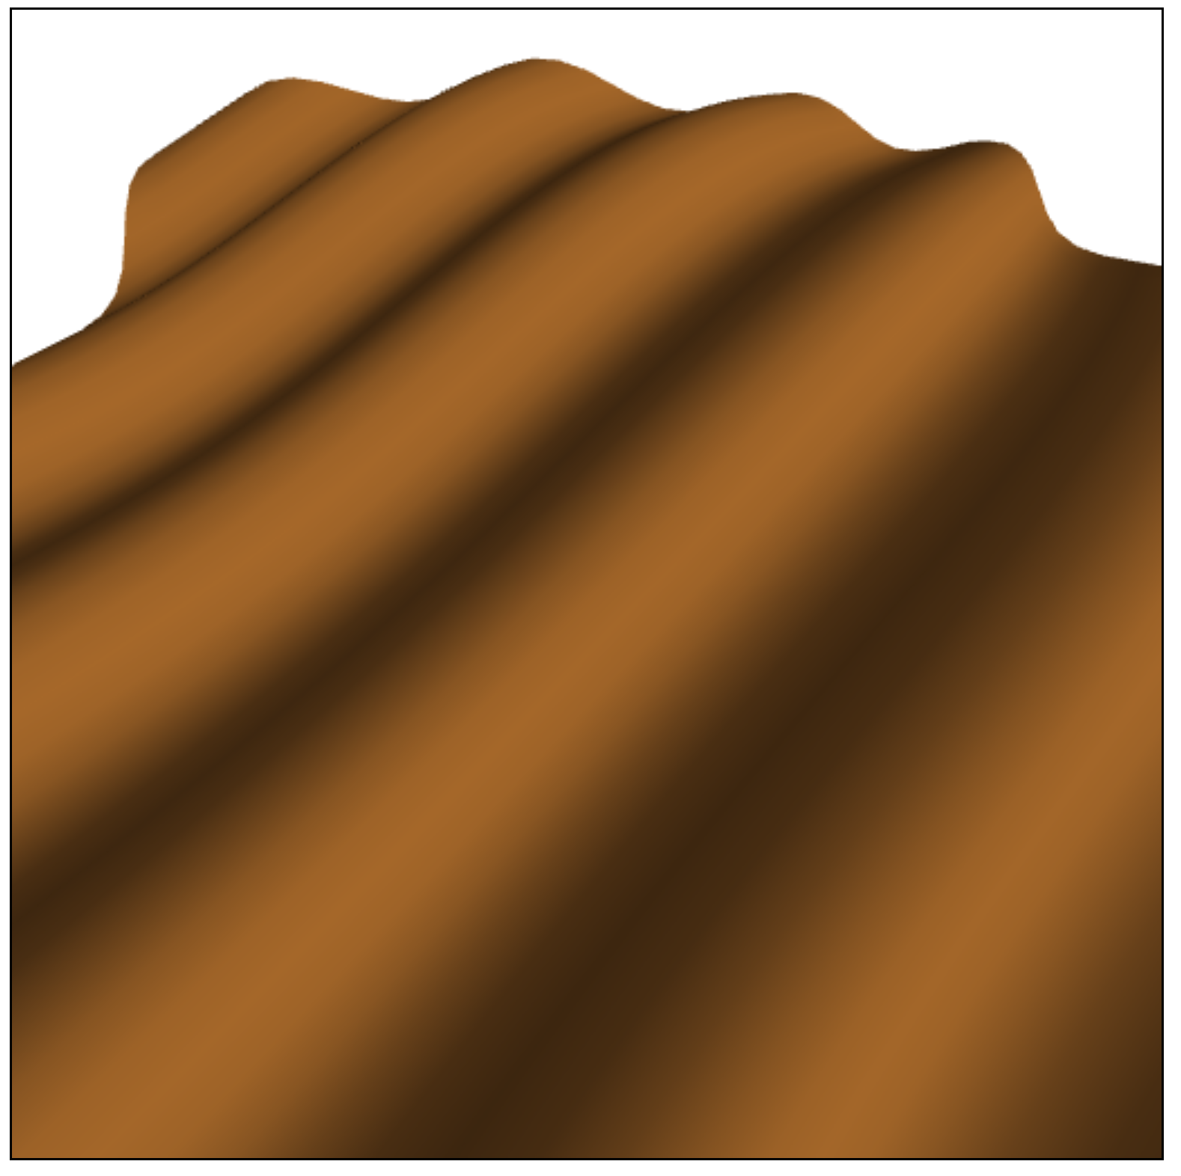
Example of a .shrek file
.25*sin((x+z)*10)+.75*sin((x+z)*10),sin((x+z)*10)-.1)+.1*sin((x-z)*2)+.02*sin((50*x-z)*2

Slide 7
Thank you!
Do you have any questions?

